Slide 1
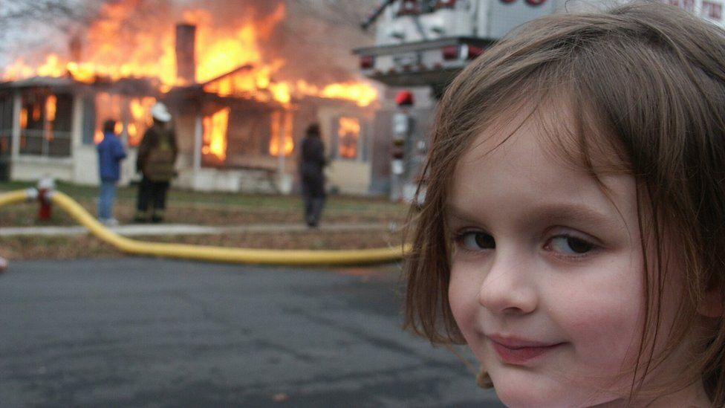
State of the Nation
An overview of capital market conditions Richard Lunt FIA

Slide 2
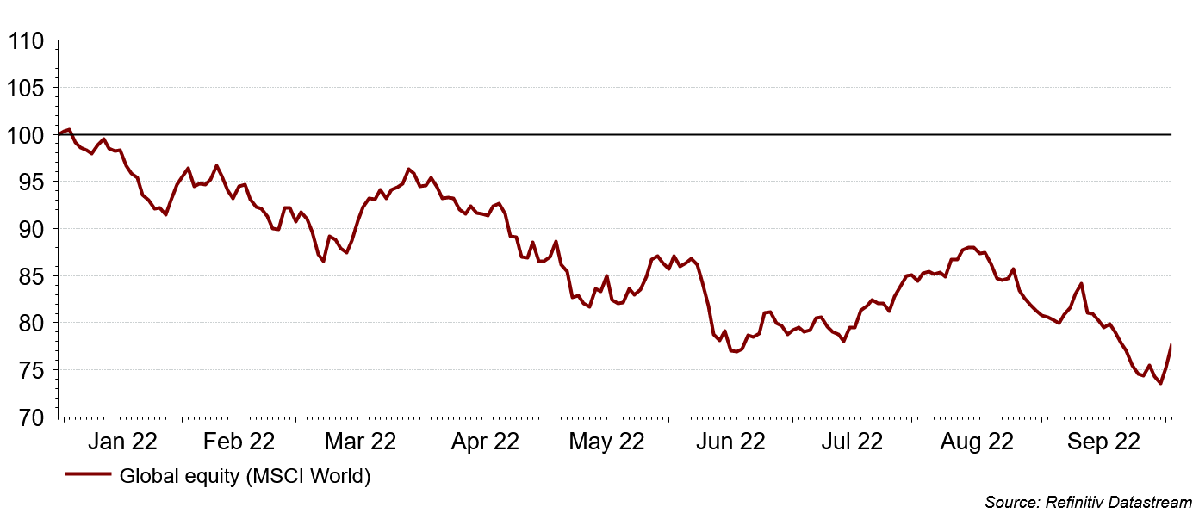
Global equity markets – 2022 to-date
Significant global developed market equity falls

Slide 3
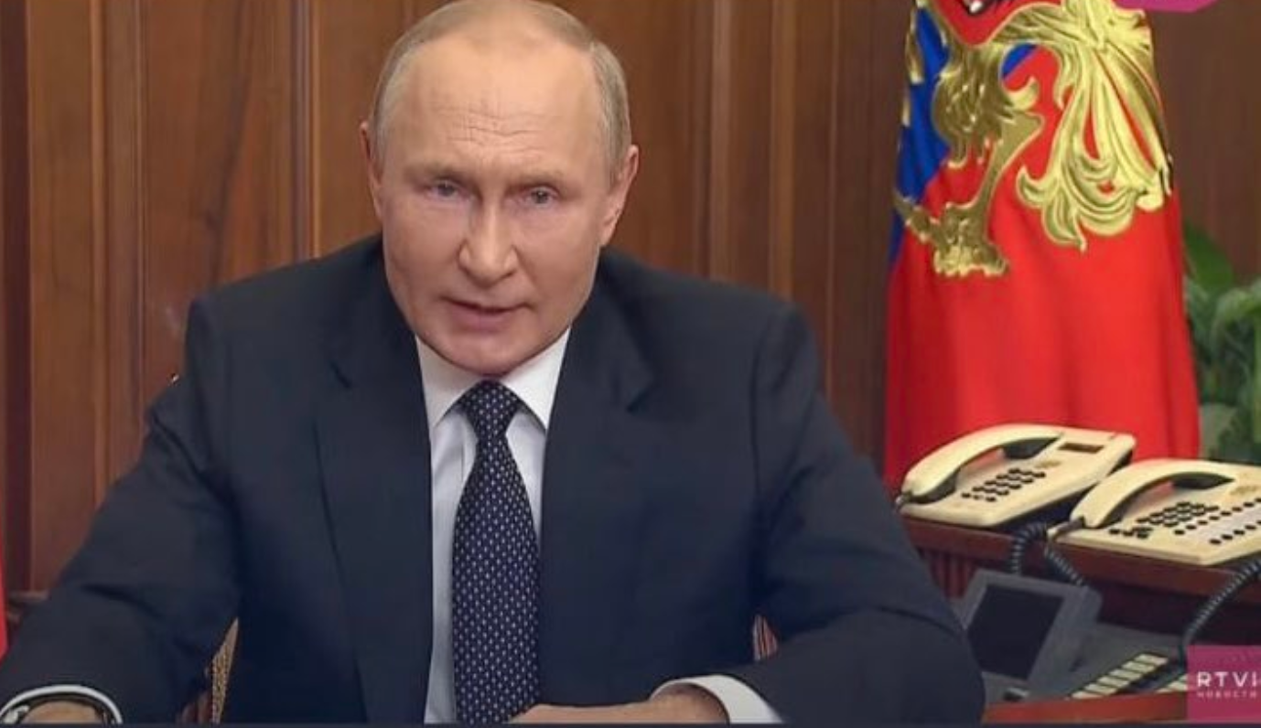
Why have global markets struggled?
There are a few main reasons
Nature
Man-made

Slide 4
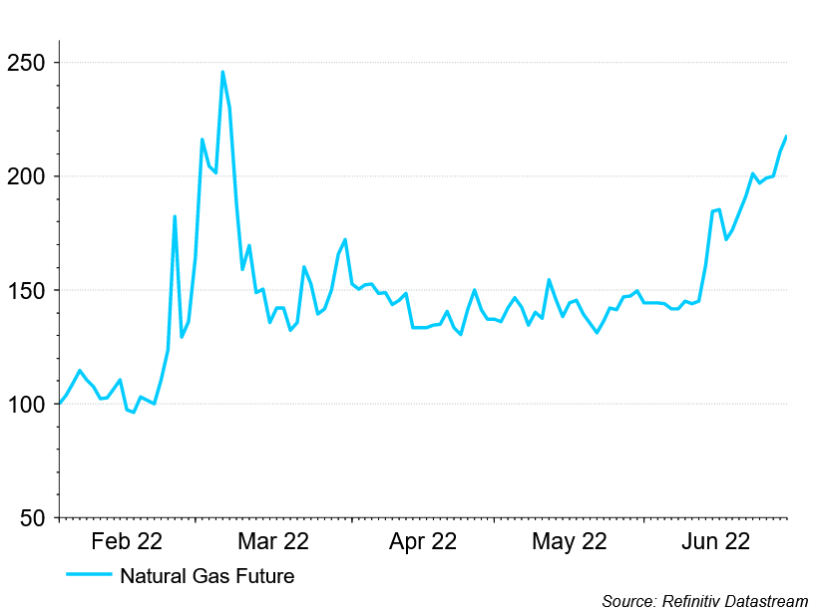
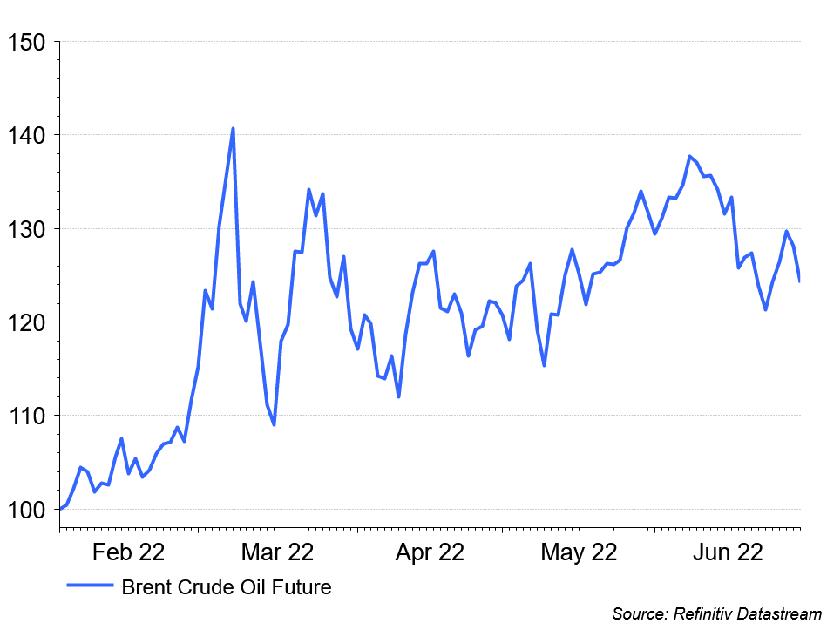
Significant rise in commodity prices to mid-year
Oil and gas futures both significantly increased
Gas Price
Oil Price

Slide 5
But wait… has the UK bucked the global economic trend?

Slide 6
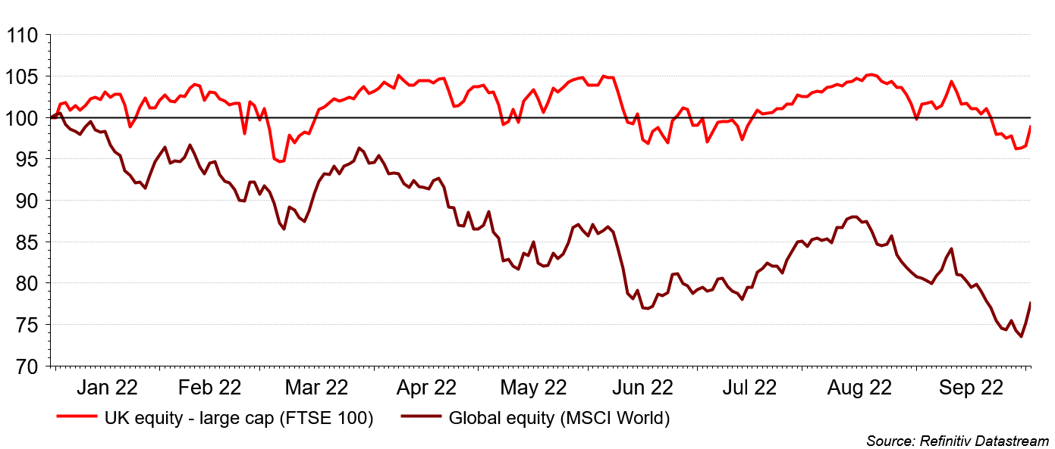
But wait… has the UK bucked the global economic trend?
UK equity performance has bucked the trend…but why?

Slide 7
Let me tell you about the UK…
Blighty…a summary

Slide 8
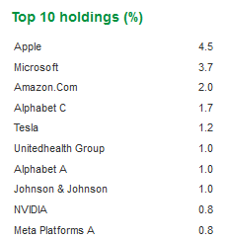
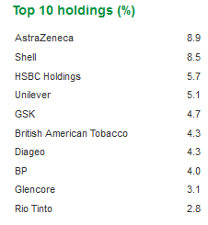
Let me tell you about the UK…
A concentrated stock market
Top 10 holdings…17.5% of the market
Top 10 holdings…51.3% of the market
MSCI World
FTSE 100

Slide 9
United Kingdom: Fact file
A concentrated stock market – biased towards pharmaceuticals, oil companies and banks.

Slide 10
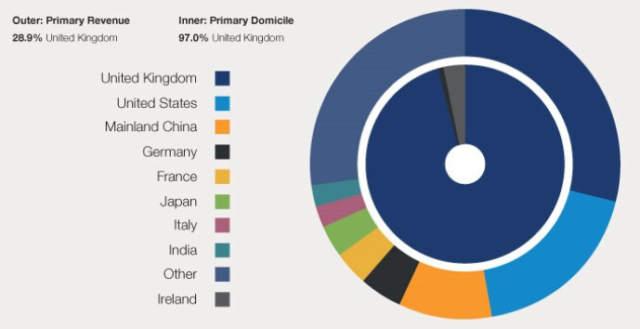
Let me tell you about the UK…
Significant overseas revenues from the FTSE 100
Source: Schroders (first published in 2017)

Slide 11
United Kingdom: Fact file
A concentrated stock market – biased towards pharmaceuticals, oil companies and banks.
Considerable overseas revenues – around 75% of income generated overseas

Slide 12
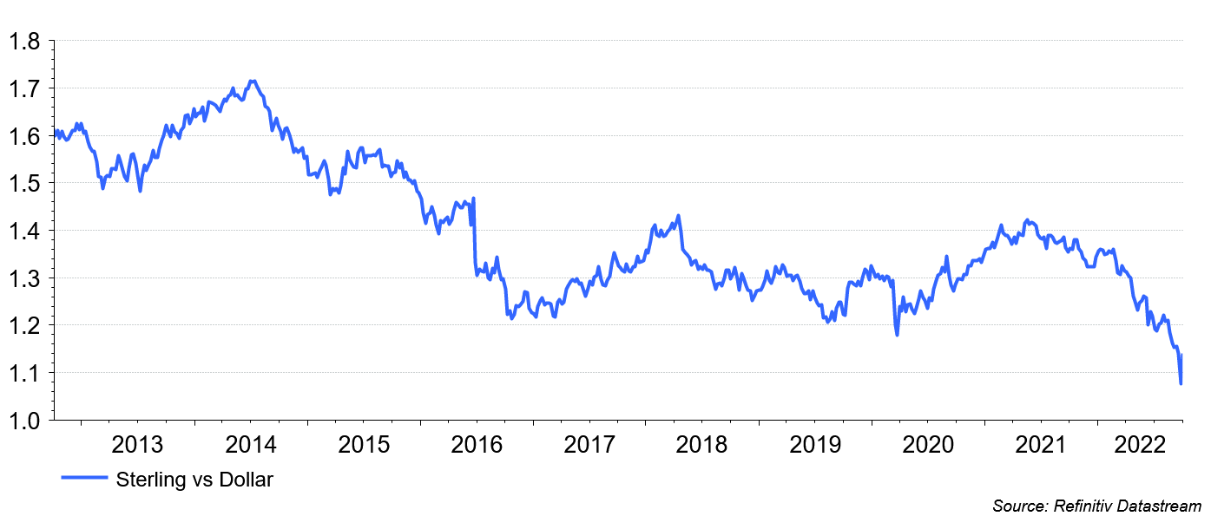
Currency: Sterling vs Dollar
Considerable weakening of Sterling over recent years.

Slide 13
United Kingdom: Fact file
A concentrated stock market – biased towards pharmaceuticals, oil companies and banks.
Considerable overseas revenues – around 75% of income generated overseas
A depreciating currency – $1.40 to close to parity within a year

Slide 14
United Kingdom: Fact file
A concentrated stock market – biased towards pharmaceuticals, oil companies and banks.
Considerable overseas revenues – around 75% of income generated overseas
A depreciating currency – $1.40 to close to parity within a year
All of these facts would serve to significantly bolster the FTSE 100 given market conditions in 2022 to-date

Slide 15
But wait… has the UK bucked the global economic trend?
UK equity performance has bucked the trend

Slide 16
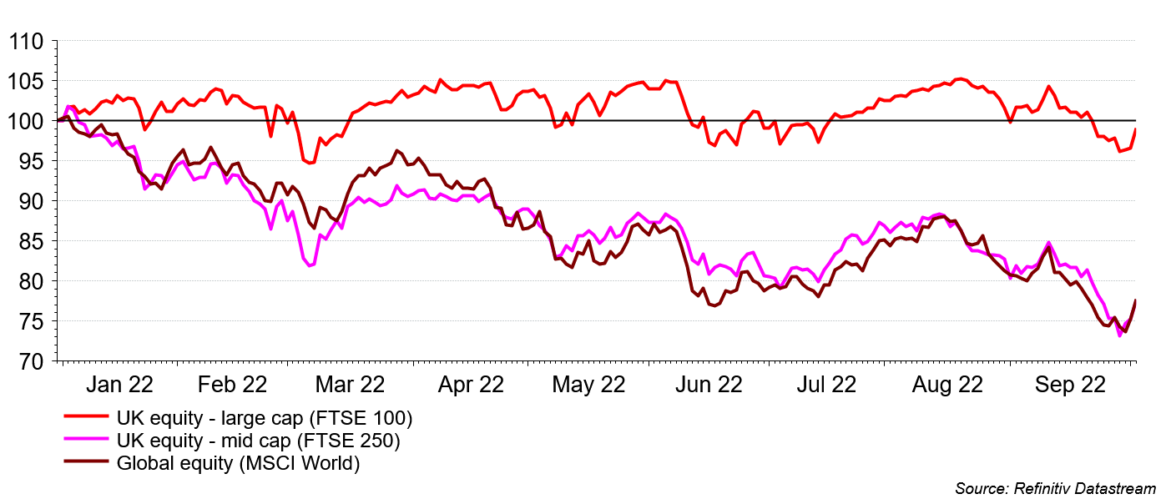
But wait… has the UK bucked the global economic trend?
UK equity performance has bucked the trend… for the large cap stocks

Slide 17
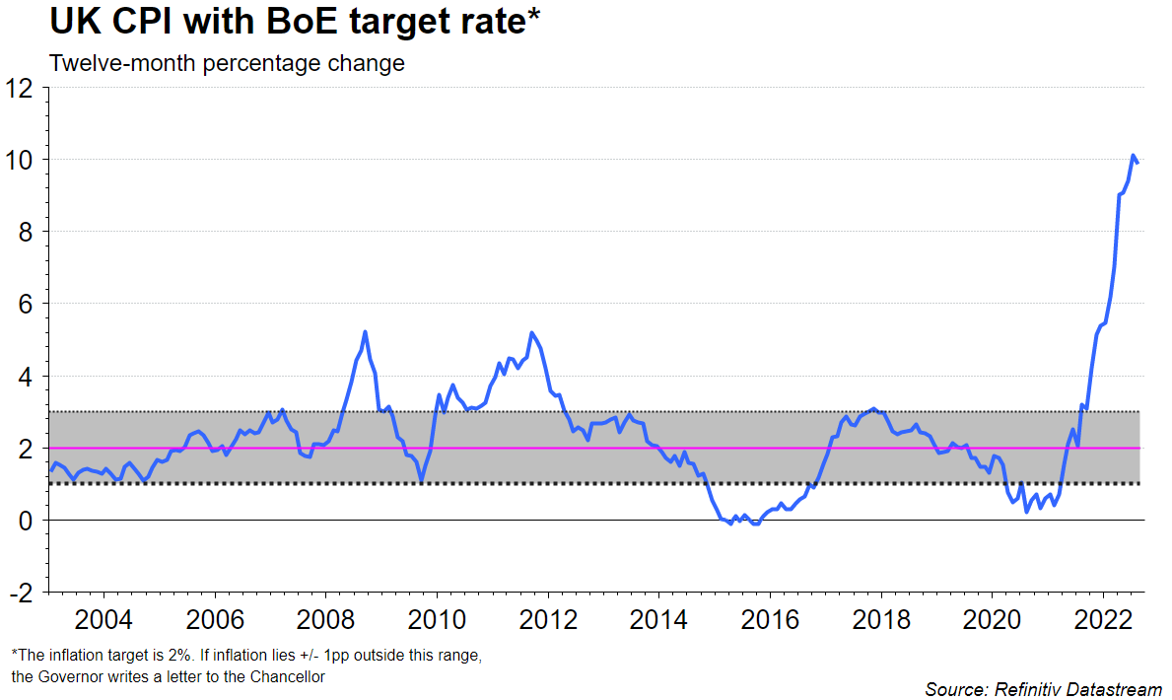
UK CPI inflation

Slide 18
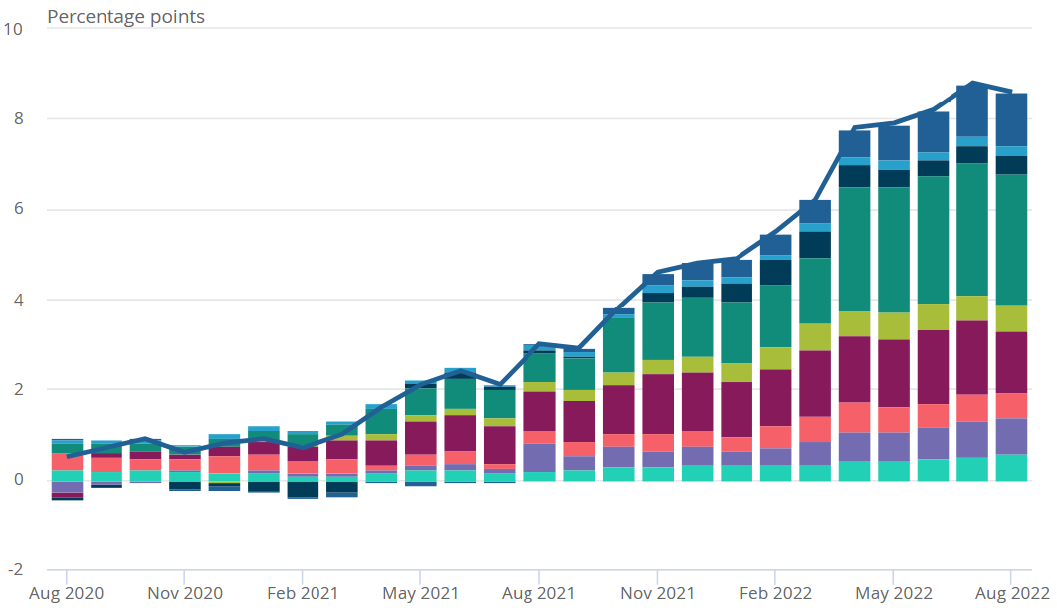
UK CPI inflation – contributary factors

Slide 19
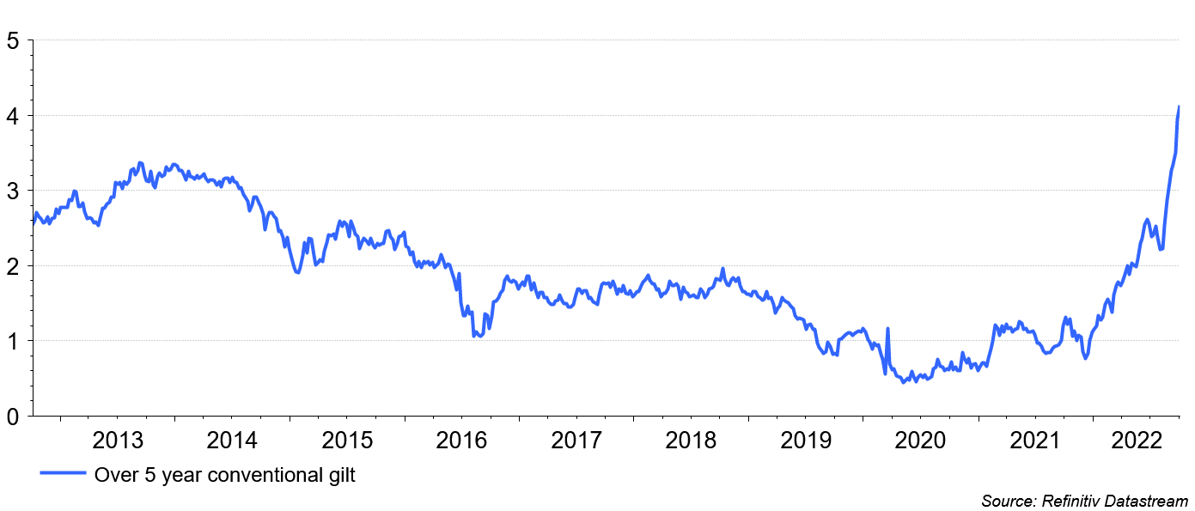
The gilt yield has risen… very significantly
Everybody knows that base rates will rise… including the market

Slide 20
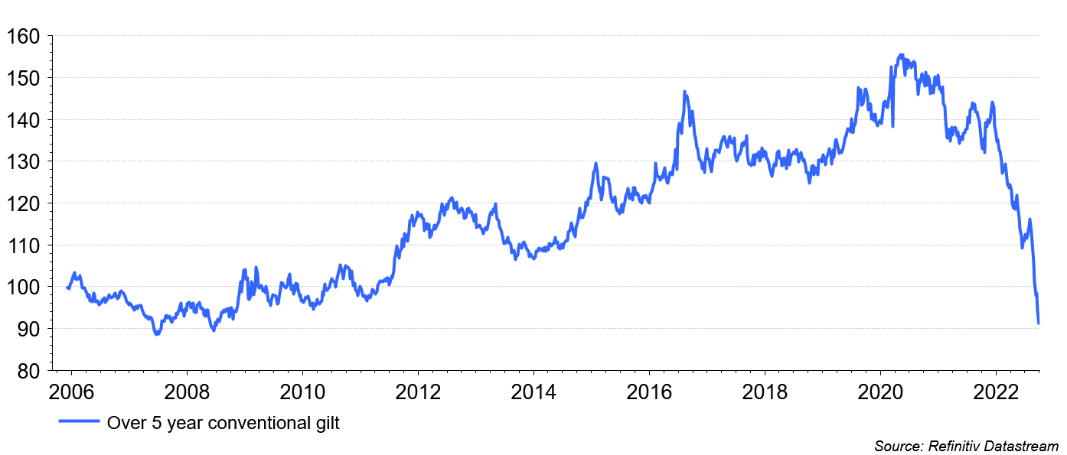
The value of gilts has fallen… very significantly
Everybody knows that base rates will rise… including the market

Slide 21
Liability Driven Investments (LDI)
What is LDI again?
Capital efficient hedging with built-in leverage mitigation protocols
Relatively modest leverage levels
Day-to-day line of defence 1: Recapitalisation protocol: Cash in / out (to keep leverage within a range)
Day-to-day line of defence 2: Manually reduce leverage via asset sales if recapitalisation won’t reach the LDI fund in time.

Slide 22
Let me tell you about the UK… supplemental information
Blighty…a summary
A concentrated stock market – biased towards pharmaceuticals, oil companies and banks.
Considerable overseas revenues – around 75% of income generated overseas
A depreciating currency – $1.40 to close to parity within a year
And also….
Uncertainly associated with ‘the B word’ – and it’s not ‘Boris’
Relatively high levels of debt – debt to GDP of 102% with an 8% budgetary deficit
Political uncertainty – … and financial markets do not like uncertainty

Slide 23
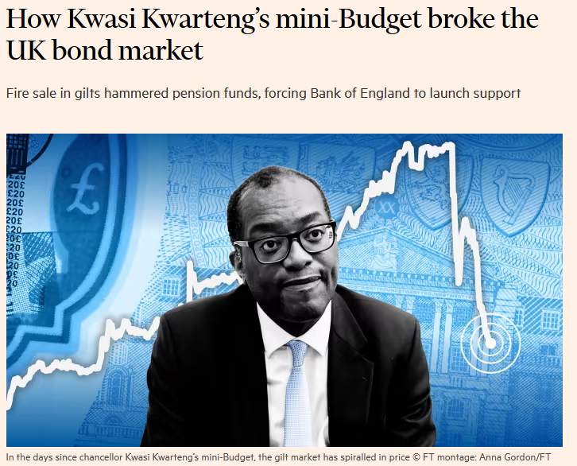
Let’s get bang up-to-date… why are UK markets stressed?
It’s for the same reasons that other domestic economies are struggling, plus……
… but what does this mean for LDI investment?

Slide 24
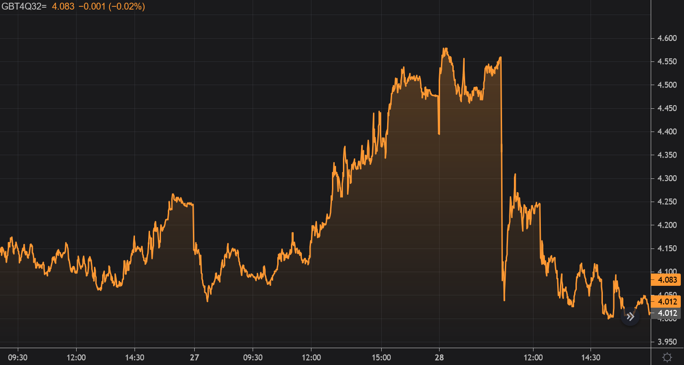
Week commencing 26 October 2022…
…a run on the gilt market

Slide 25
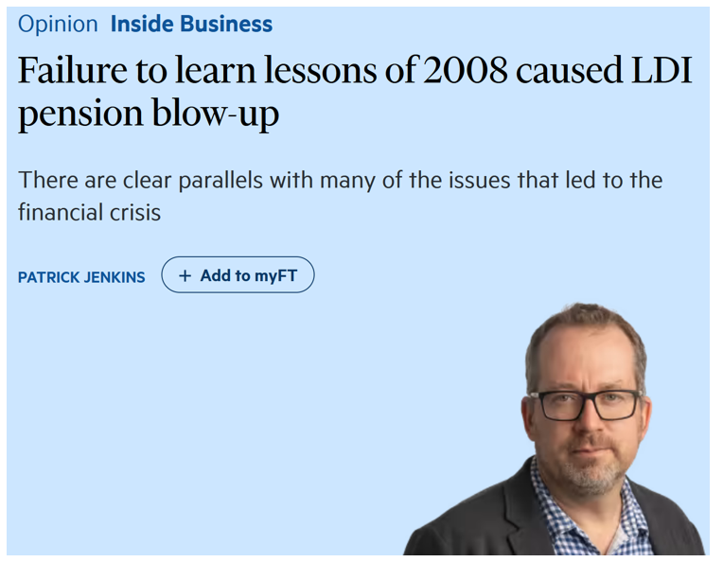
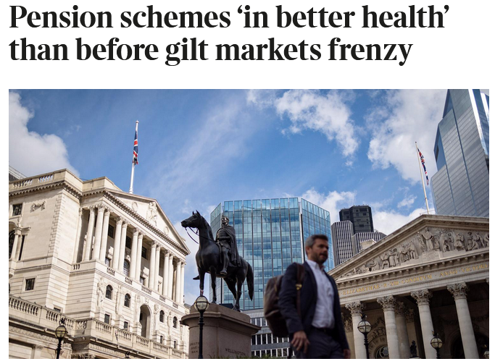
Liability Driven Investments (LDI): Who to believe…?
The prosecution
The defence

Slide 26
As we sit here today…
The particular circumstances of your scheme is more relevant than ever
Have you a high hedge ratio and your LDI provider has weathered the storm? You likely still have a very good position
Are you underhedged and your LDI provider has weathered the storm? Your position may have improved materially
Has your LDI provider had to cut protection? “It depends”… your advisor will be in touch…but for the significant majority of schemes it isn’t “that bad”
Do you not have LDI… The financial position may have improved considerably… you may wish to protect the improvement.

Slide 27
Portfolio positioning in today’s market environment
The market has moved… your circumstances may have changed
Is LDI still appropriate?
Is my portfolio still appropriate?
LDI as we know it will change (lower leverage), despite working in the significant majority of cases during the gilt shock
Many will continue to use LDI
LDI is not the only way to protect a position
Your financial position may have improved materially… should you protect it?
Portfolios will need rebalancing (now overweight growth, illiquids)
Stressed conditions – some issues (property) and opportunities (credit, buyout / buy-in?)
There is no substitute for scheme specific consideration including allowance or the current financial condition of the arrangement.

