Slide 1
Bulk Annuity Case Study
Craig Moran
Phil Kelly
Tristan Walker-Buck
Paul Barrett

Slide 2
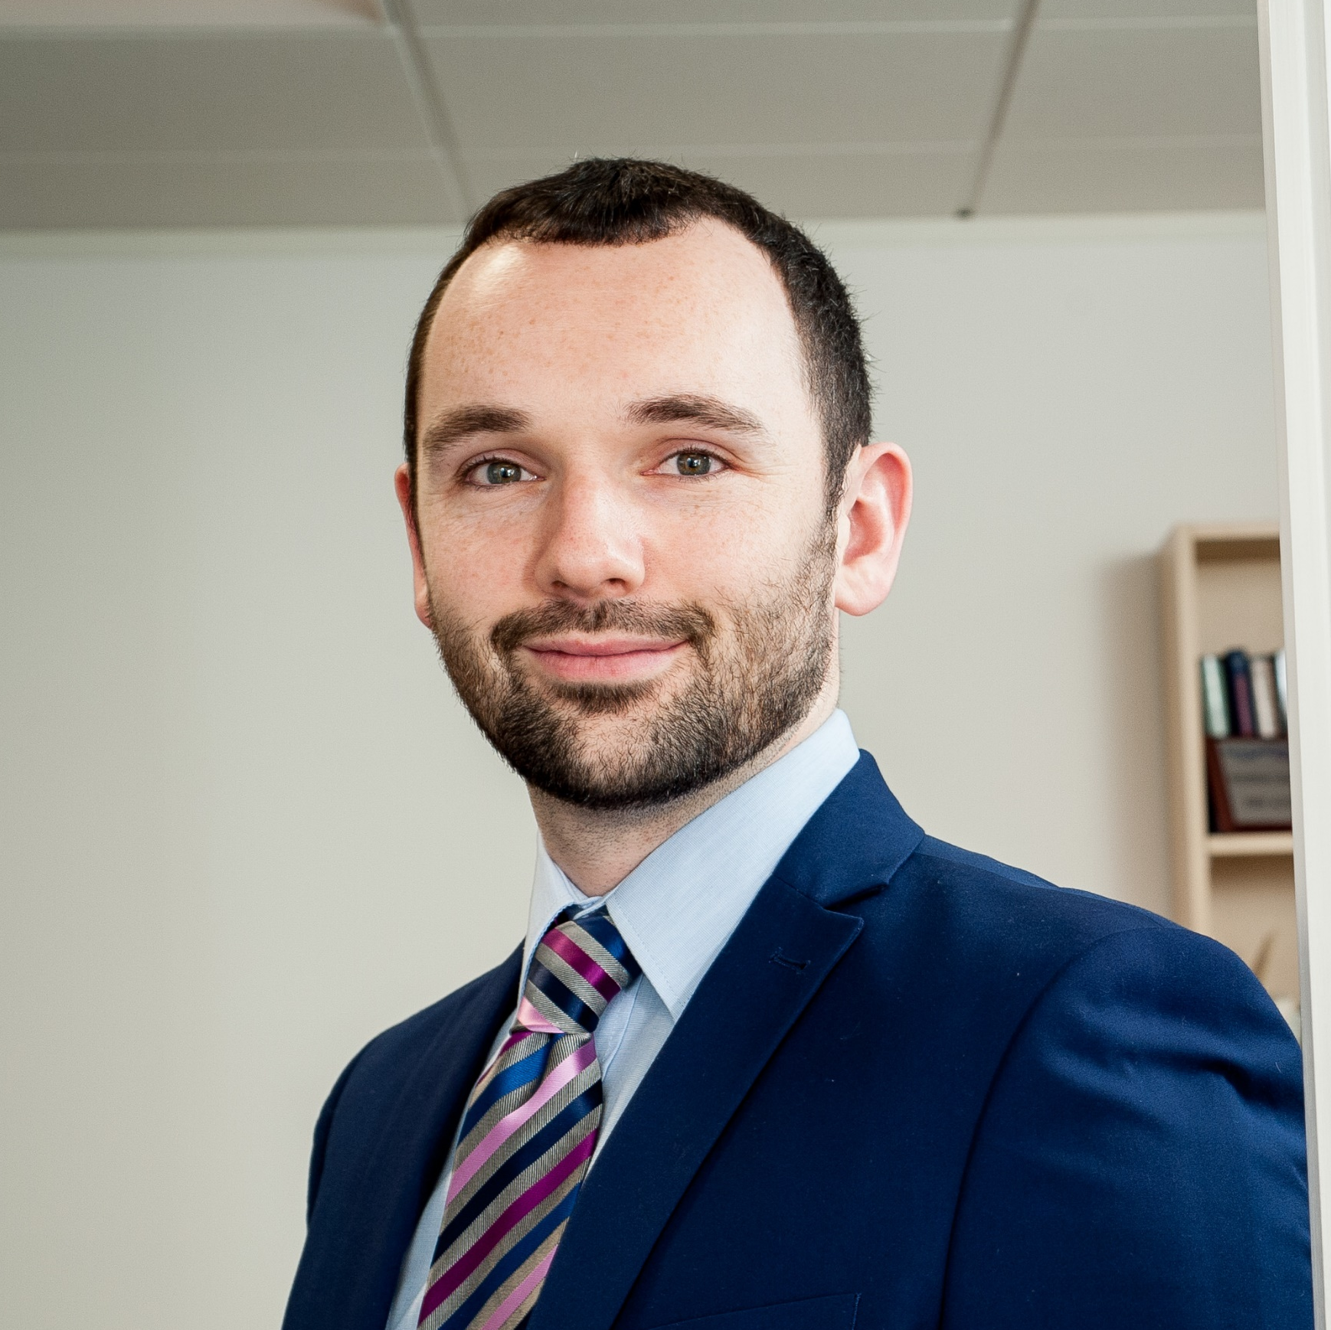
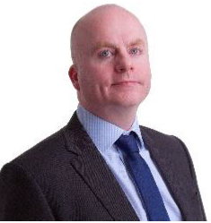
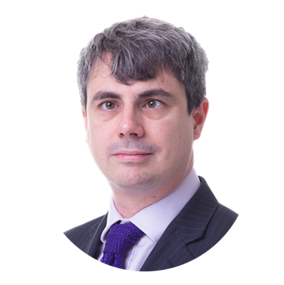
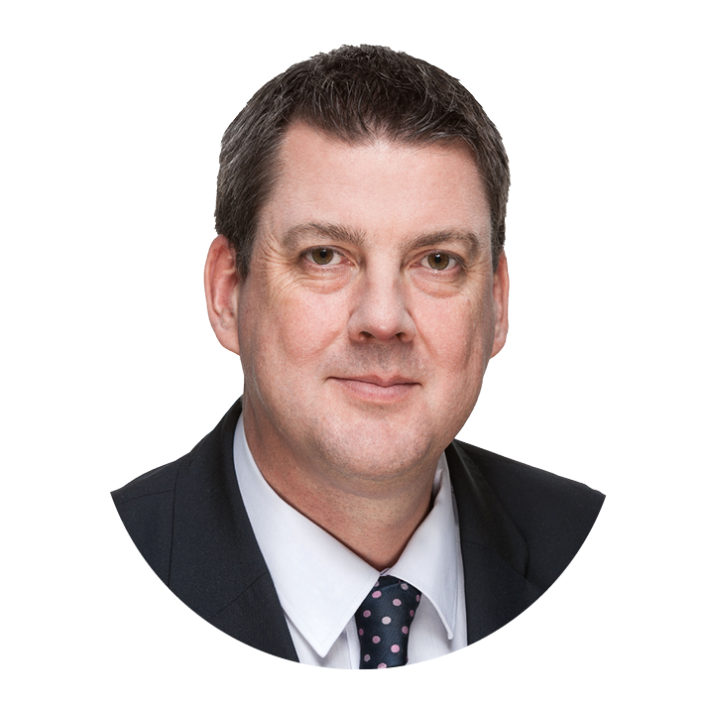

Introductions
Craig Moran
Scheme Actuary
First Actuarial
Phil Kelly
Bulk Annuity Specialist
First Actuarial
Tristan Walker-Buckton
Head of Pricing
PIC
Paul Barrett
Senior Transition Manager
PIC

Slide 3
Agenda
Current market environment
Case study of a successful buyout
Insight from PIC

Slide 4
Current market environment

Slide 5
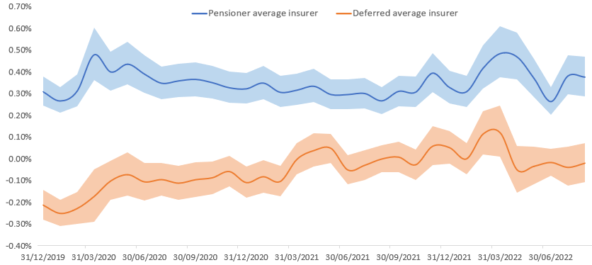
Why is the bulk annuity market so busy?
Improved funding positions
Attractive pricing (relative to other investments)
Pent up demand post Covid
Bulk annuity pricing vs gilts

Slide 6








Who is in the bulk annuity market
8 insurers in the market – but they don’t all get involved in every deal

Slide 7
2022 the story so far…
Possibility of a record year?

Slide 8



2022 the story so far…
Around £12bn of buy-ins / buy-outs over H1 2022
Major deals announced:
£2.3bn pensioner buy-in with L&G
£1.1bn
full buy-in with PIC
£1.0bn
full buy-in with Standard Life

Slide 9
Capacity issues
Insurers becoming much more selective – particularly for smaller schemes
Some insurers are already pushing quotations into next year (or refusing to quote at all)
Important for your scheme to stand out
Engage early with insurers – follow new best practice guide
Demonstrate preparation work done – clean data, detailed benefit spec etc
Be flexible over timescales and process
Ensure suitable governance arrangements are in place with sponsor on board
Carry out feasibility work in advance – insurers often ask for a ‘target’ price
For very small schemes, often have to agree exclusivity at outset

Slide 10
Case study: A success journey to buyout

Slide 11
Sponsor background
UK-based sponsoring employer became insolvent in 2010, with the Scheme headed into the PPF.
Overseas parent assumed responsibility to avoid benefit reductions.
Deficit contributions of £1.5m pa for 8 years were agreed to remove the ongoing deficit.
New sponsor had a lot of investment expertise.

Slide 12
Scheme background
First Actuarial appointed to advise the Trustees in 2012
Scheme was underfunded on buyout
Heavily invested in equities
Employer was targeting buy-in within 10 years
Buyout (£m) | 2012
Assets | 43.0
Liabilities | 70.5
Surplus / (Shortfall) | (27.5)
Funding Level | 61%

Slide 13

How the Scheme got to buyout
Contributions
Investment returns
Member options

Slide 14
Liability management
Trustees and sponsor worked together to provide options that were a ‘win-win’ for all parties.
Liability management exercises included:
  Enhanced transfer-values
  Trivial commutation
  Providing retirement quotes & CETVs for members aged 55, 60 and 65
Early retirement offer was very popular with members, many of whom were not aware they could retire before age 65.

Slide 15
Change in position since 2012
Solvency (£’m) | 2012 | 2015 | 2018 | 2021
Surplus / (Shortfall) | (27.5) | (21.4) | (10.4) | 4.8
Funding Level | 61% | 71% | 86% | 107%

Slide 16
Timeline to buy-in
Feb 2021 – June 2021: Feasibility Report prepared. Agreement reach to proceed, insurers provide with ‘early notice’ of intent.
Oct 2021 – Feb 2022: Data issued to insurers, initial quotes received and shortlist prepared.
Feb 2022: Material surplus identified, decision made to de-risk investments to protect position.
Mar 2022 to May 2022: Final quotes received, final insurers interviewed and exclusivity agreement entered with PIC.
June 2022: Contract signed, premium paid and contract goes ‘live’.

Slide 17
Surplus decisions
2021 valuation results and insurer quotes indicated a material surplus.
Legal advice confirmed that any the decision on how any remaining assets were used lay with the sponsor.
Intervention of the sponsor meant that members avoided the PPF and received full benefits.
View was taken that any surplus was to be returned to the sponsor.
Potentially an issue for more schemes given recent market conditions. Very scheme specific, trustees and employers should understand what their rules require.

Slide 18
How we assisted the Trustees
Liability management ahead of buy-in
Thorough data work and benefit specification
Price negotiations to agree ‘best and final’ price
Beauty parade to assess project management and member experience
Managing disinvestment of funds in turbulent market conditions
Early engagement with insurers to provide notice of intent

Slide 19
First Actuarial Client Conference .
Thursday 6th October 2022
Tristan Walker-Buckton | Head Of Pricing
Paul Barrett | Senior Transition Manager

Slide 20
Introductions
Tristan Walker-Buckton | Head of Pricing
Paul Barrett| Senior Transition Manager
Tristan joined PIC in 2006 shortly after its inception and has since worked on over 50 completed insurance transactions, amounting to £10bn+.
He has led or been heavily involved in transactions such as the £1bn+ buyouts with Thorn and EMI, the £1.6bn buy-in with Total and the £750m longevity swap conversion with SSE. Most recently he led on the £1.1bn deal with the EDS 1994 Pension Scheme.
Paul joined PIC in 2011, he was previously a Client Manager at Willis Towers Watson
Since joining PIC, Paul has transitioned 36 schemes, covering 37,000 members with assets of over £7.3bn. In addition Paul has overseen the transition of a further 37 schemes covering 79,000 members with assets of £12.9bn

Slide 21
Brief overview of PIC.
(not a sales pitch…)
Tristan Walker-Buckton | Head of Pricing

Slide 22





Introduction to PIC
Pension Insurance Corporation plc (“PIC”) is a UK insurer authorised by the PRA and regulated by the PRA and FCA
The purpose of PIC is to pay the pensions of its current and future policyholders
Specialist, focused insurer
  Simple business model
  Investing in customer care
Key outcomes of our purpose:
  Policyholders: receive a guaranteed pension for life.
  Society: more than £10 billion invested in social infrastructure, including social housing, renewable energy and the UK’s universities.
  Investors: long-term and supportive.
Share of buy-in/ buyout sector by volume over the last ten years (PIC company estimate)
Share of buy-in/buyout sector 2011-2021
Total = c.£194bn
Our awards

Slide 23











Selected transactions
£1.4bn
£250m
2021
2020
2020
2020
2019
2019
£2.2bn
£2bn
£1.6bn
£937m
British Steel
£425m
£140m
2019
2018
Metal Box Pension Scheme
Full Buyout
Old British Steel Pension Scheme
Full Buyout
Merchant Navy Officers Pension Fund
Pensioner Buy-in
Schemes sponsored by Co-op
Three pensioner buy-ins across 2019 and 2020
M&S Pension Scheme
Pensioner Buy-in
WPP – 7 schemes
Two buyouts and a pensioner buy-in across 2018 and 2019
2019
2019
2018
2018
2016
2013
£750m
£209m
£1.5bn
£772m
£250m
£16m
Scottish Hydro Electric Pension Scheme
Pensioner Buy-in
Kingfisher Pension Scheme
Pensioner Buy-in
Rentokil Initial Pension Scheme
All Risks Buyout
BHS2 Pension Scheme
Full Buyout
Smiths Industries Pension Scheme Pensioner Buy-in
The Institute and
Faculty of Actuaries
Staff Pension Scheme
Pensioner Buy-in

Slide 24
Project Piano Case Study.
Tristan Walker-Buckton| Head of Pricing

Slide 25





Project Piano
    ‘Maiden transaction’ with First Actuarial as brokers
    Simple process – two round auction process
    Data write-out exercise completed prior to market approach
    Price feedback and shortlisting. Opportunity to meet Trustees.
    Selected. Agreed a price lock tailored to Scheme’s investments
    Efficient contract agreement process run by First Actuarial and Eversheds.

Slide 26
Member Experience.
Paul Barrett| Senior Transition Manager

Slide 27





What our customers can expect of us
A secure,
timely pension.
Communications
in plain English.
Excellent
customer service.
Wider social impact.

Slide 28








PIC administration
Four times Institute of Customer Service Award winners
PIC has a very hands-on relationship and controls the administration process
Your members
PIC dedicated
helpline
Workflow and
Imaging
Technology suite
All our policyholders (your members) receive extremely high levels of service

Slide 29


PIC administration
PIC is fully engaged with everything our administrators do
We check
We sign off every process for a new scheme
We reconcile every pension payment we make
We check every pension increase payment
We listen to the longest phone calls every month
We read every
complaint letter
We are responsible
for everything our
Administrators do

Slide 30





PIC policyholder engagement
Policyholder satisfaction surveys
Clear communication channels
Low levels of complaints
Trustee aftercare
PIC monitors its satisfaction surveys closely
Focus on providing a high-quality service for our policyholders
Dedicated freephone UK-based helpline
Over 100 documents Crystal Marked giving us Platinum status
Dedicated member self-service website allowing online transfers and retirement quotes, contact detail updates and viewing / printing of payslips and P60
We work closely with our administration team to ensure complaint levels are low.
0.89 reportable complaints per thousand policyholders in H1 2021
0.56 reportable complaints per thousand policyholders in H2 2021
Our lowest complaints since 2015
Trustee Governance – Part of PIC’s standard service to clients
PIC represents a significant investment by the trustee
There is no further investment advice on this asset
Important that PIC provides an annual update to Trustees with a max. 30 min slot at one trustee meeting per year (or as required)
99.6%
of respondents are “satisfied or better”
with our service in 2021
86.7%
Gave PIC’s service the maximum score
>97%
Maintained above
97% Satisfaction for
the last 9 years
Underpinned by our values and culture

Slide 31
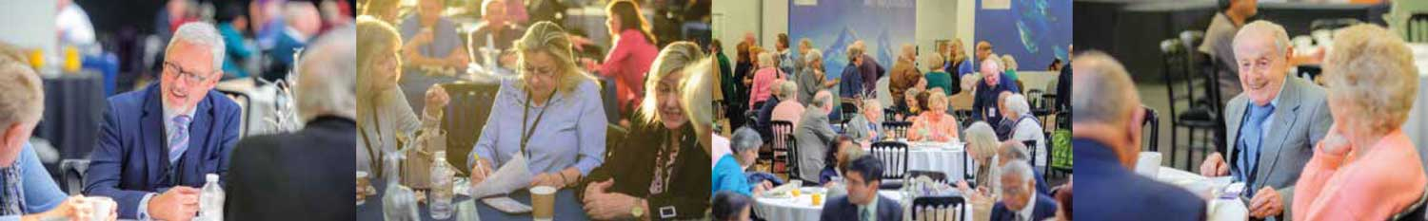
Policyholder satisfaction
PIC Policyholder Communications
  PIC usually arranges:
      Three Policyholder Days, and
      Three Policyholder lunches
      every year; as well as
      Two online policyholder events for 2022
  We held our first virtual Policyholder Hour in December 2020
Existing pensioner relationships
  PIC welcomes existing pensioner groups
  PIC attends annual meetings for
  a number of Pensioner groups
      A chance to discuss member concerns
      Provide an update on PIC
      Meet policyholders face-to-face
      Continued connection to the
      original scheme
  Important part of communications and member engagement
  PIC is happy to engage with existing groups through the buyout process
  Ongoing attendance as required
Policyholder satisfaction is a key part of PIC’s ongoing commitment
to market-leading customer service.

Slide 32






The Institute of Customer Service
PIC joined the Institute of Customer Service (ICS) in May 2015
  They are:
    An independent not for profit professional membership body
    Over 450 organisational members across many sectors
  Their aim:
    To help organisations strengthen their business performance by improving their customers’ experience
  Benefits of membership and achievements:
    Keeping ahead of the competition
    Research & Knowledge – sharing best practice and market intelligence
    ServiceMark Accreditation – awarded to PIC in December 2015
    Awarded ServiceMark with Distinction in October 2017 (re-accredited 2020)
    Won awards at four of the last five annual ICS awards

Slide 33







Administration developments
Biometric App introduced in 2021 for overseas existence checks to make this process easier
“Retire online” being rolled out in 2022
“Screen sharing” currently being developed for call handling
Working in partnership with Capita to continually improve customer service supported by appropriate technology
Communication and vulnerable customer projects underway to enhance customer outcomes

Slide 34
Tristan Walker-Buckton
Head of Pricing
0207 105 2113
walker-buckton@pensioncorporation.com
Paul Barrett
Senior Transition Manager
0207 105 2254
barrett@pensioncorporation.com

